Slide 1
GET TOP-3
MINI PROJECT
PRESENTATION
Presented By-
Vishal Sharma
Abhishek Kumar
Shikha Parashar
Rushtam Singh
Aman Gulwani

Slide 2
Contents
Objective
Introduction
Software and Hardware requirements
Technology used
Some Screenshots from the website
About the project

Slide 3
Objective
This project aims at developing a website that depicts the online selection of various electronic gadgets like smart watches , smart phones, laptops etc
It is designed in such a way that one can view all the updates from any place through online and can save them for later reference. It will provide a quick and easy comparison of different products for the customers.

Slide 4
Introduction
Using this website, people can minimize their tasks hence saving their time. This web application provides aid to people from around the country for all their gadget needs.
It is mainly a web interface for users who are looking for the best product according to their relevance. People can provide custom constraints and get the top 3 recommendations.

Slide 5
Software and Hardware Requirements
Hardware :
A computer with basic specifications.
RAM: 2 GB and above.
Processor: intel dual core and above
Software:
Visual Studio Code
PhpStorm
Apache Netbeans

Slide 6
Technology Used
HTML : It is used by developers to define structure of the webpage. Every page you see on browser is written using HTML. Web-Browser read and understand the markup text in HTML.
CSS : CSS stands for Cascading Style Sheets. To define style of the Web Page that is, type of font, its size, background-color etc. ,we use CSS. Using CSS, you can define, how each element of your web-page should look. Browser read HTML and CSS together to define the web page.

Slide 7
Bootstrap: Bootstrap is a free and open source CSS framework directed at responsive, mobile first front end development. It contains CSS- and (optionally) JavaScript-based design templates for typography, forms, buttons, navigations, and other interface components.
PHP: PHP is a general-purpose scripting language that is especially suited to web development
MySQL: MySQL is an open source relational database management system (RDBMS) SQL is a language programmers use to create, modify and extract data from the relational database, as well as control user access to the database.

Slide 8
SCREENSHOTS
FROM THE WEBSITE

Slide 9
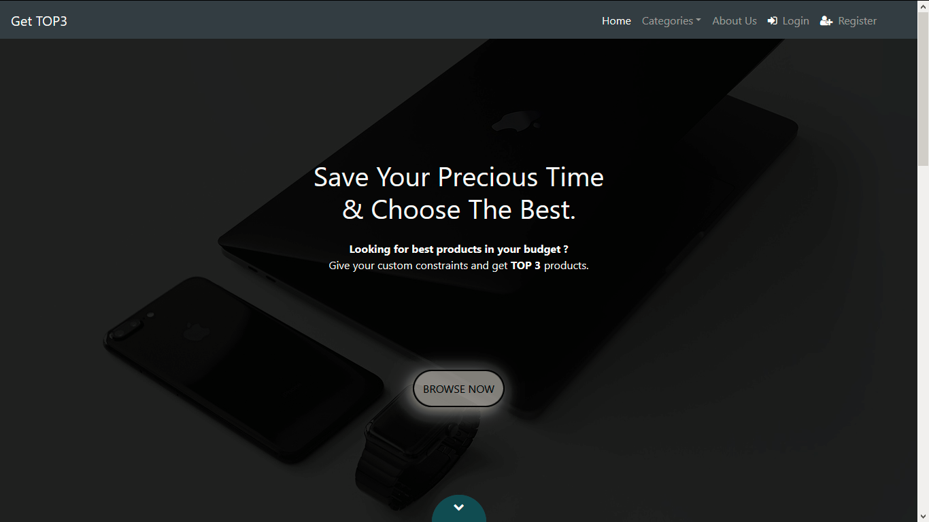

Slide 10
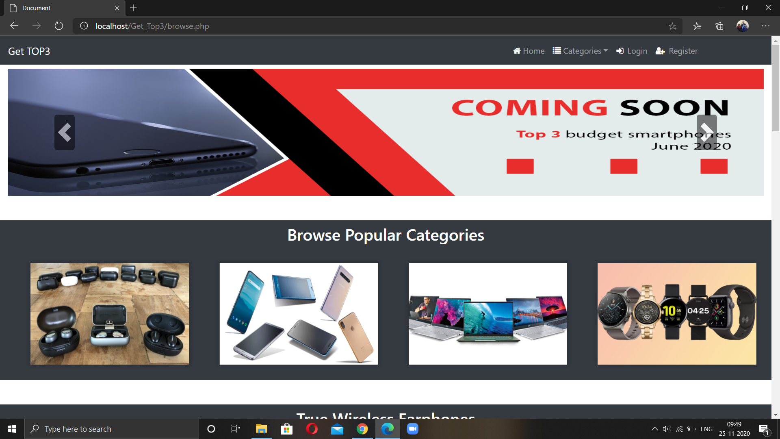

Slide 11
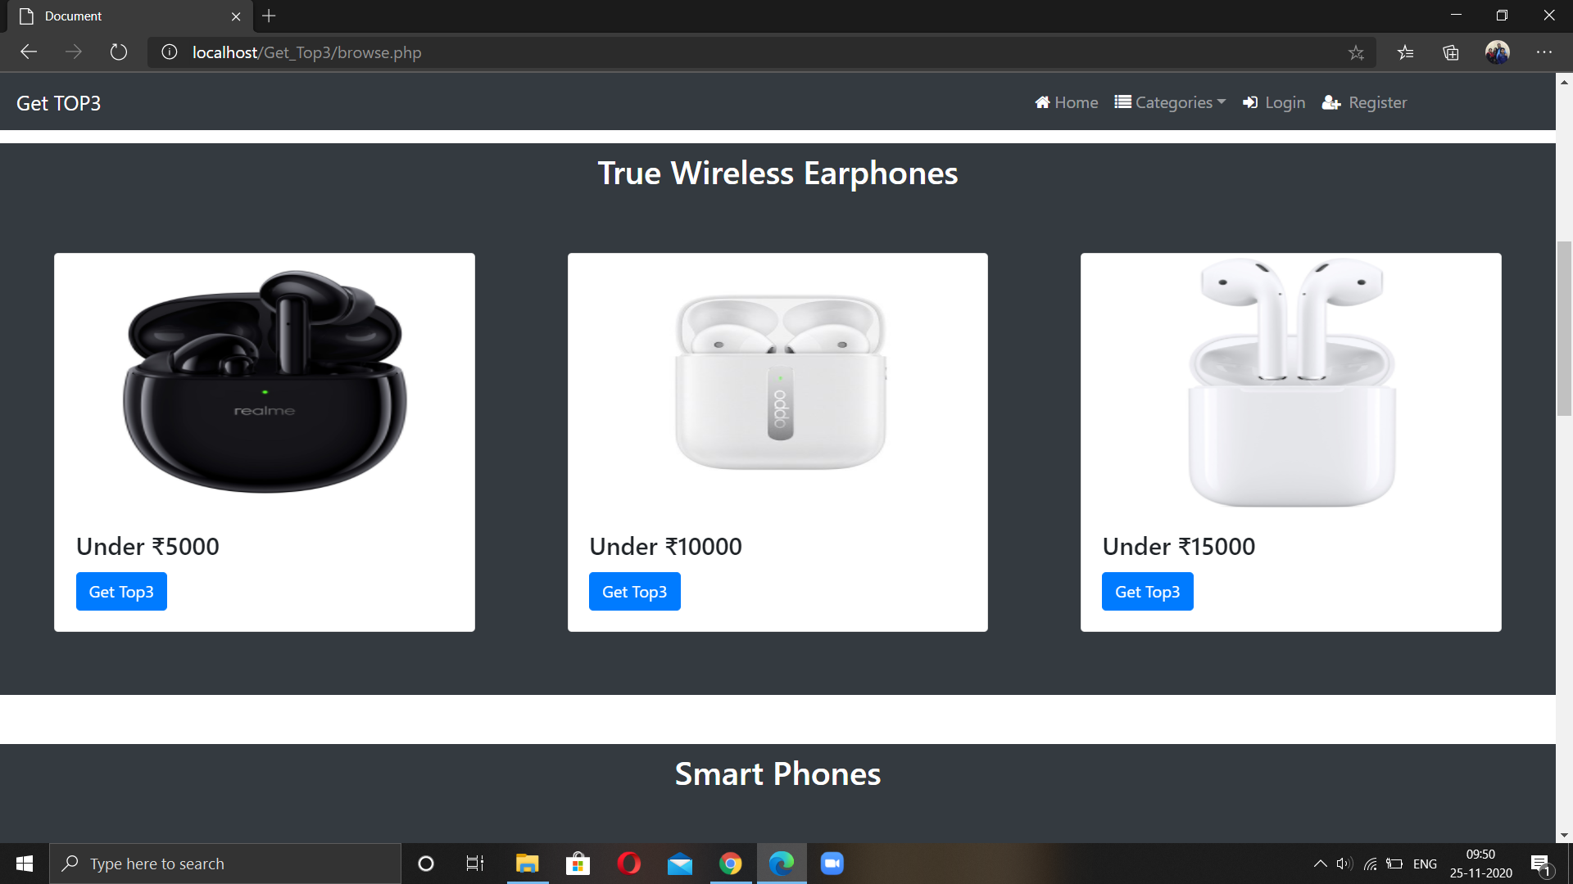

Slide 12
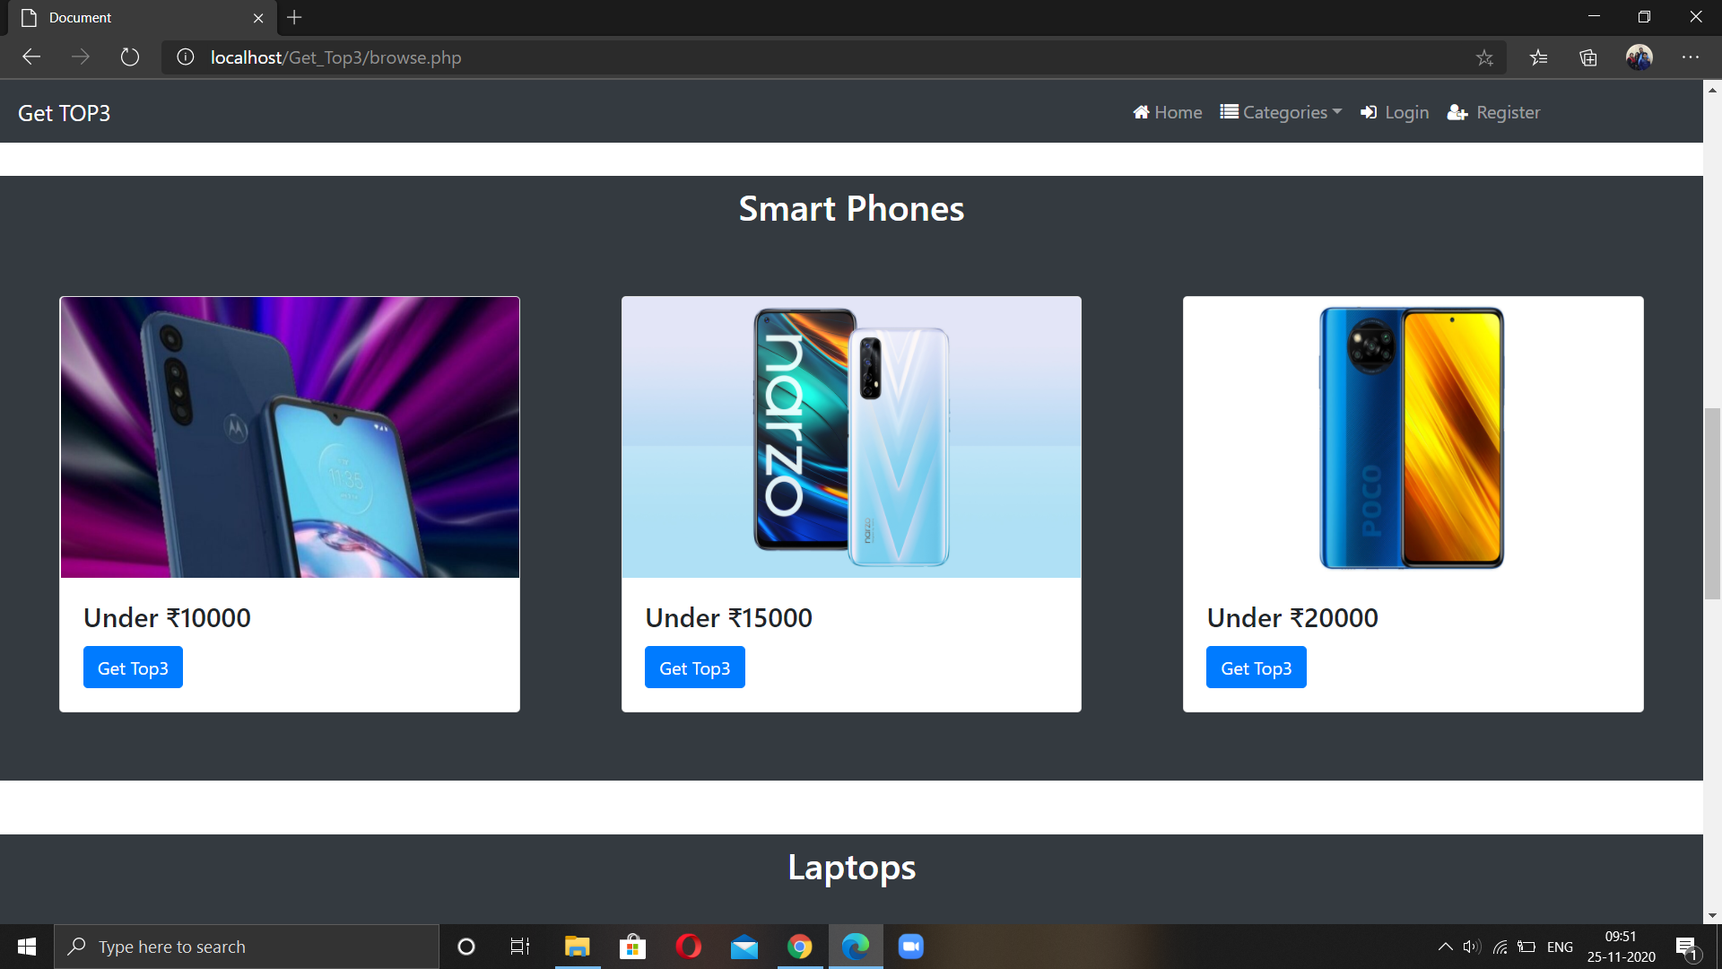

Slide 13
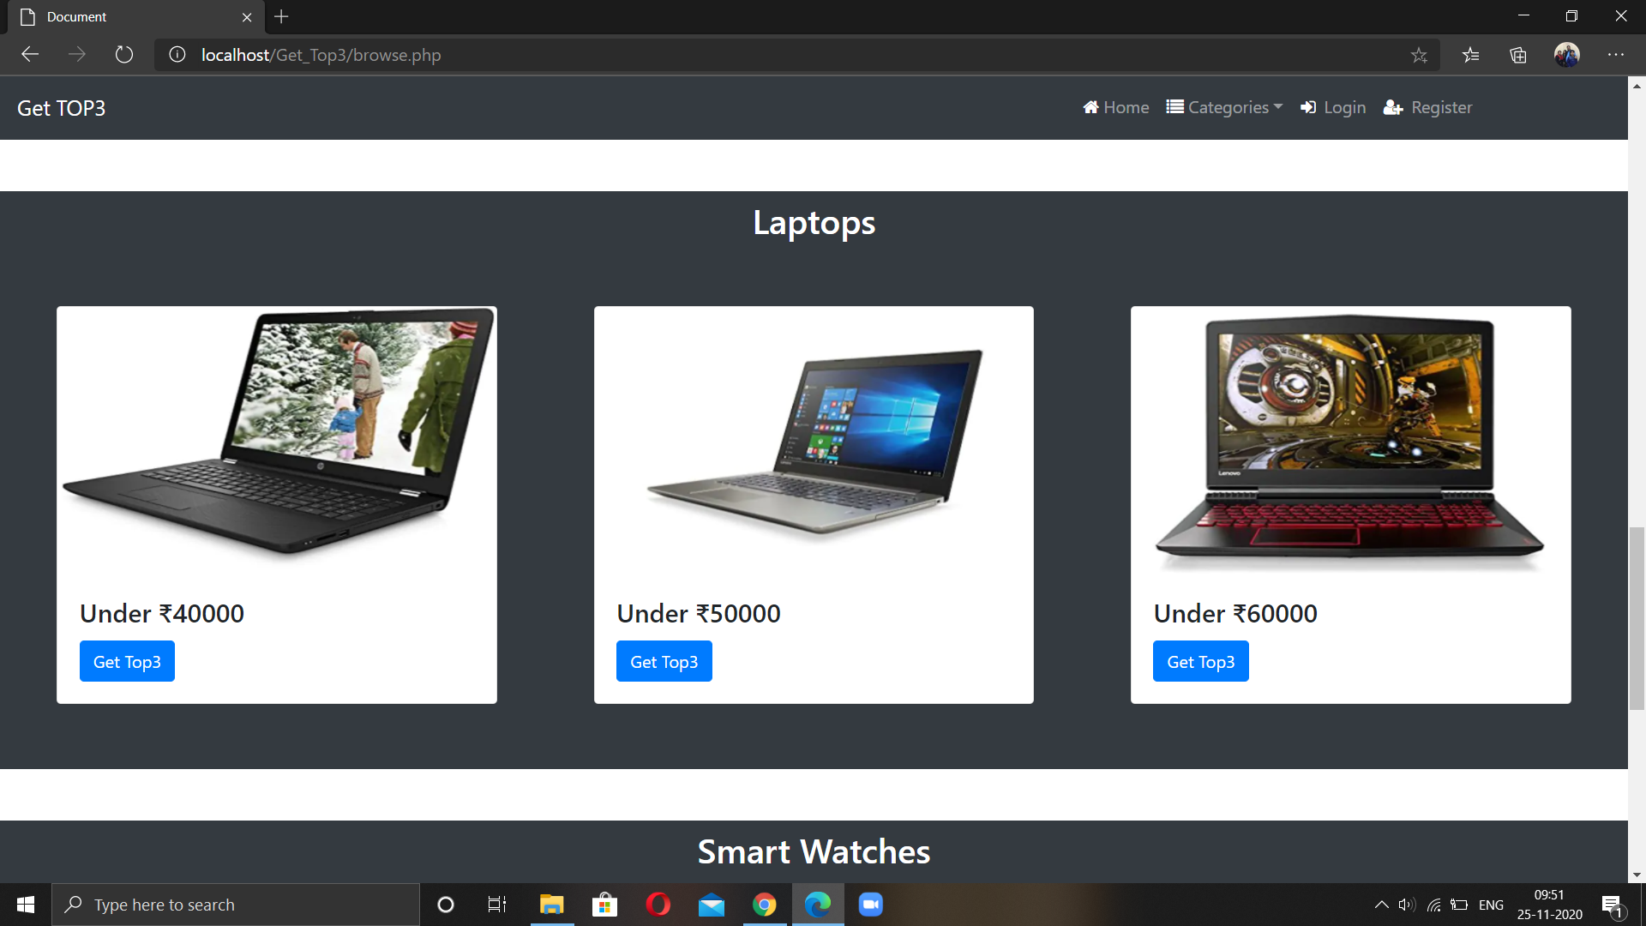

Slide 14
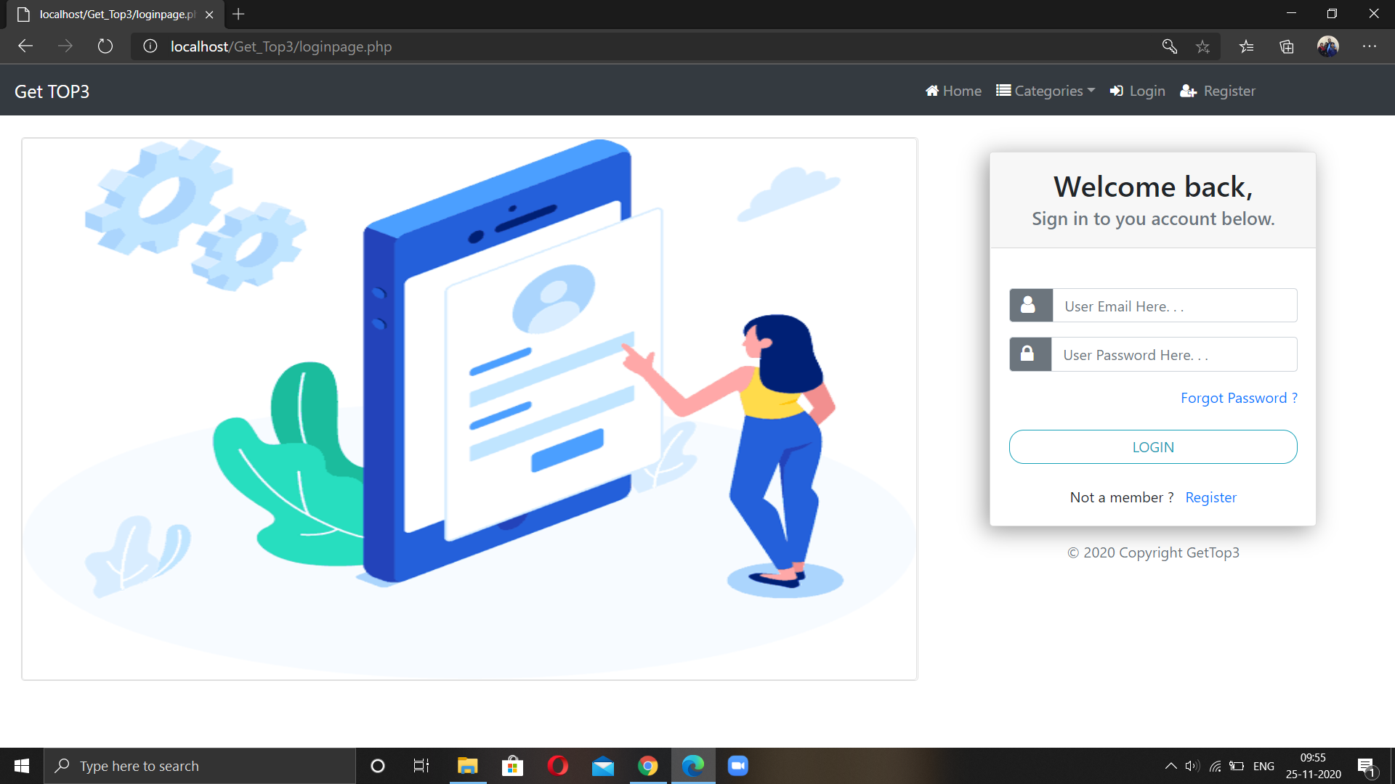

Slide 15
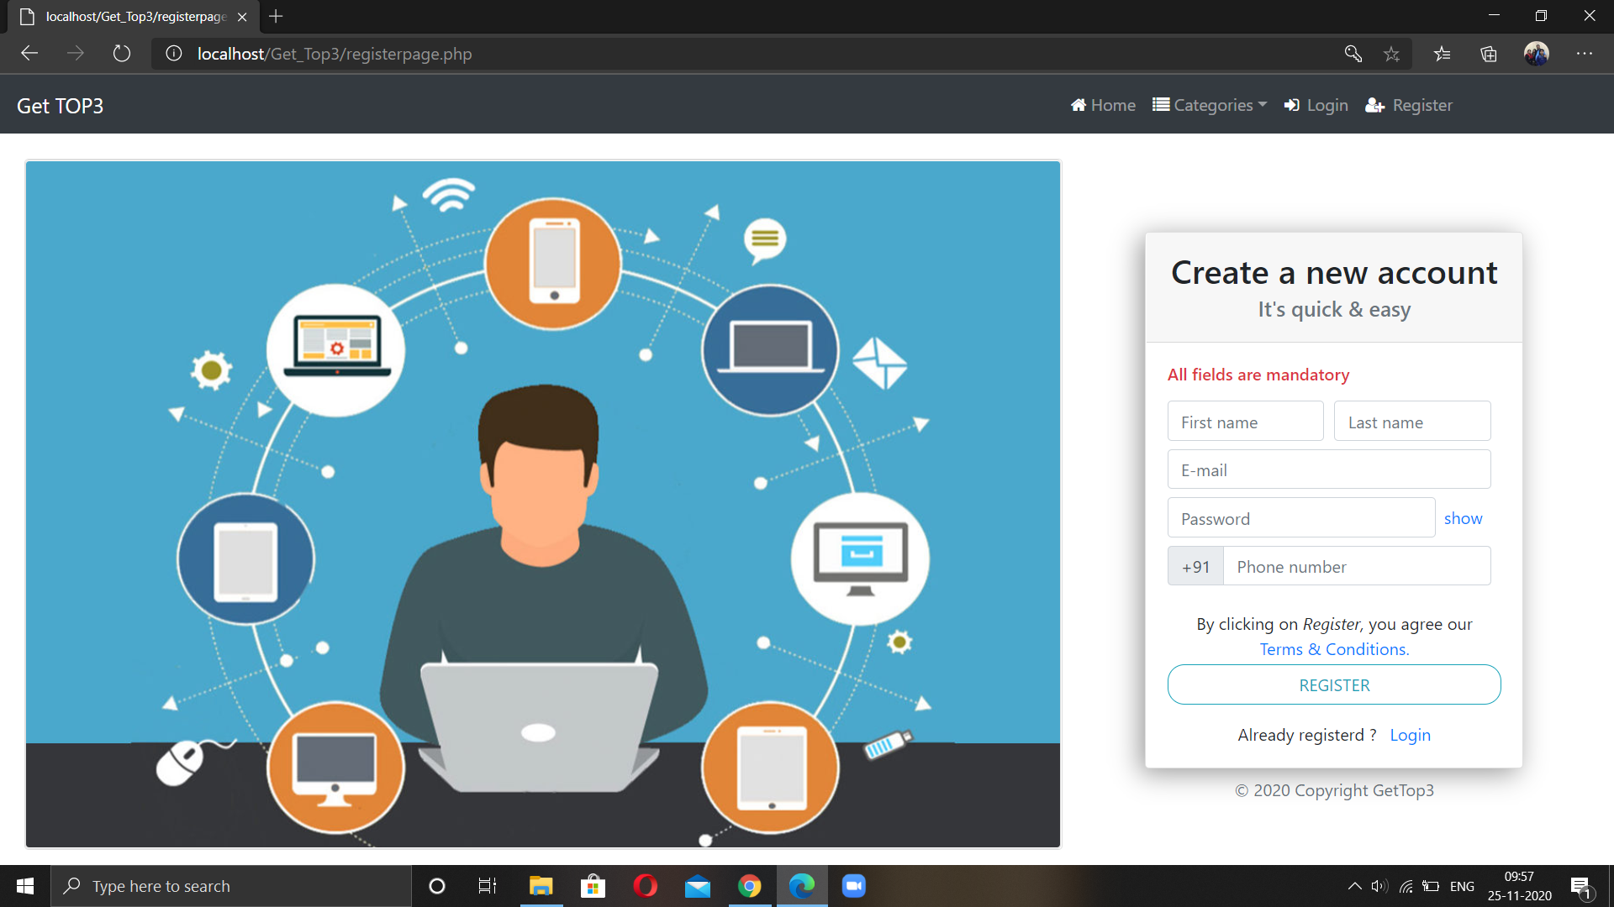

Slide 16
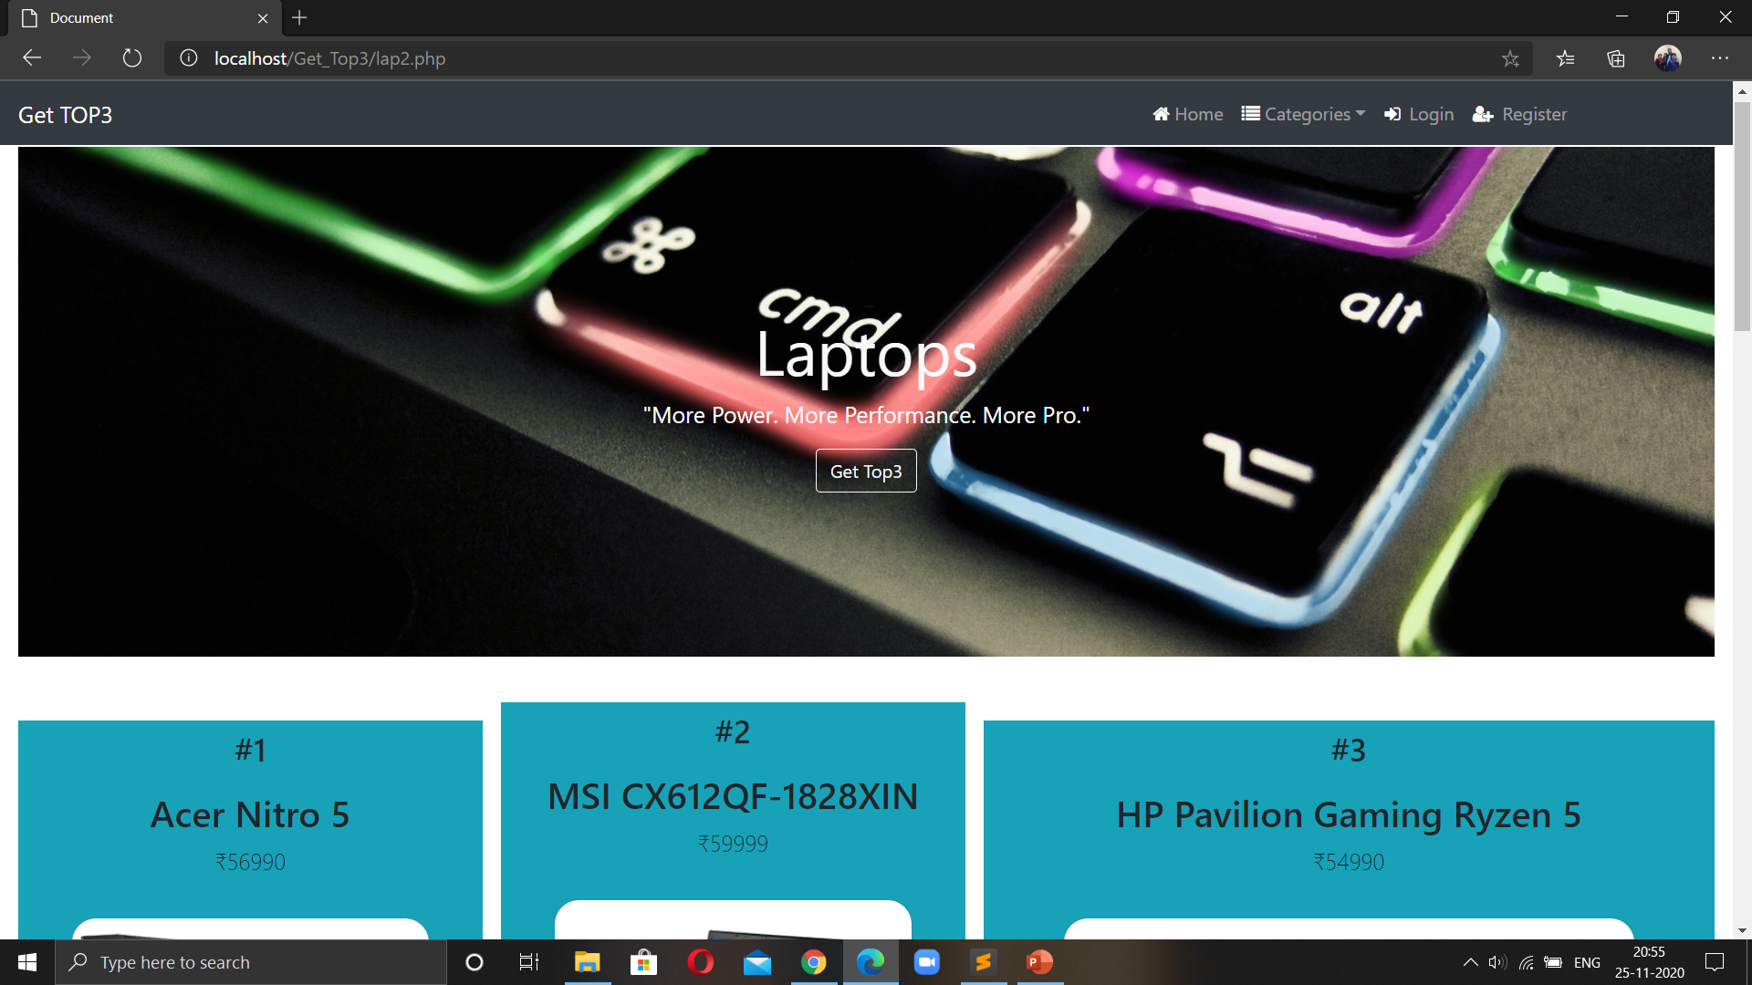

Slide 17
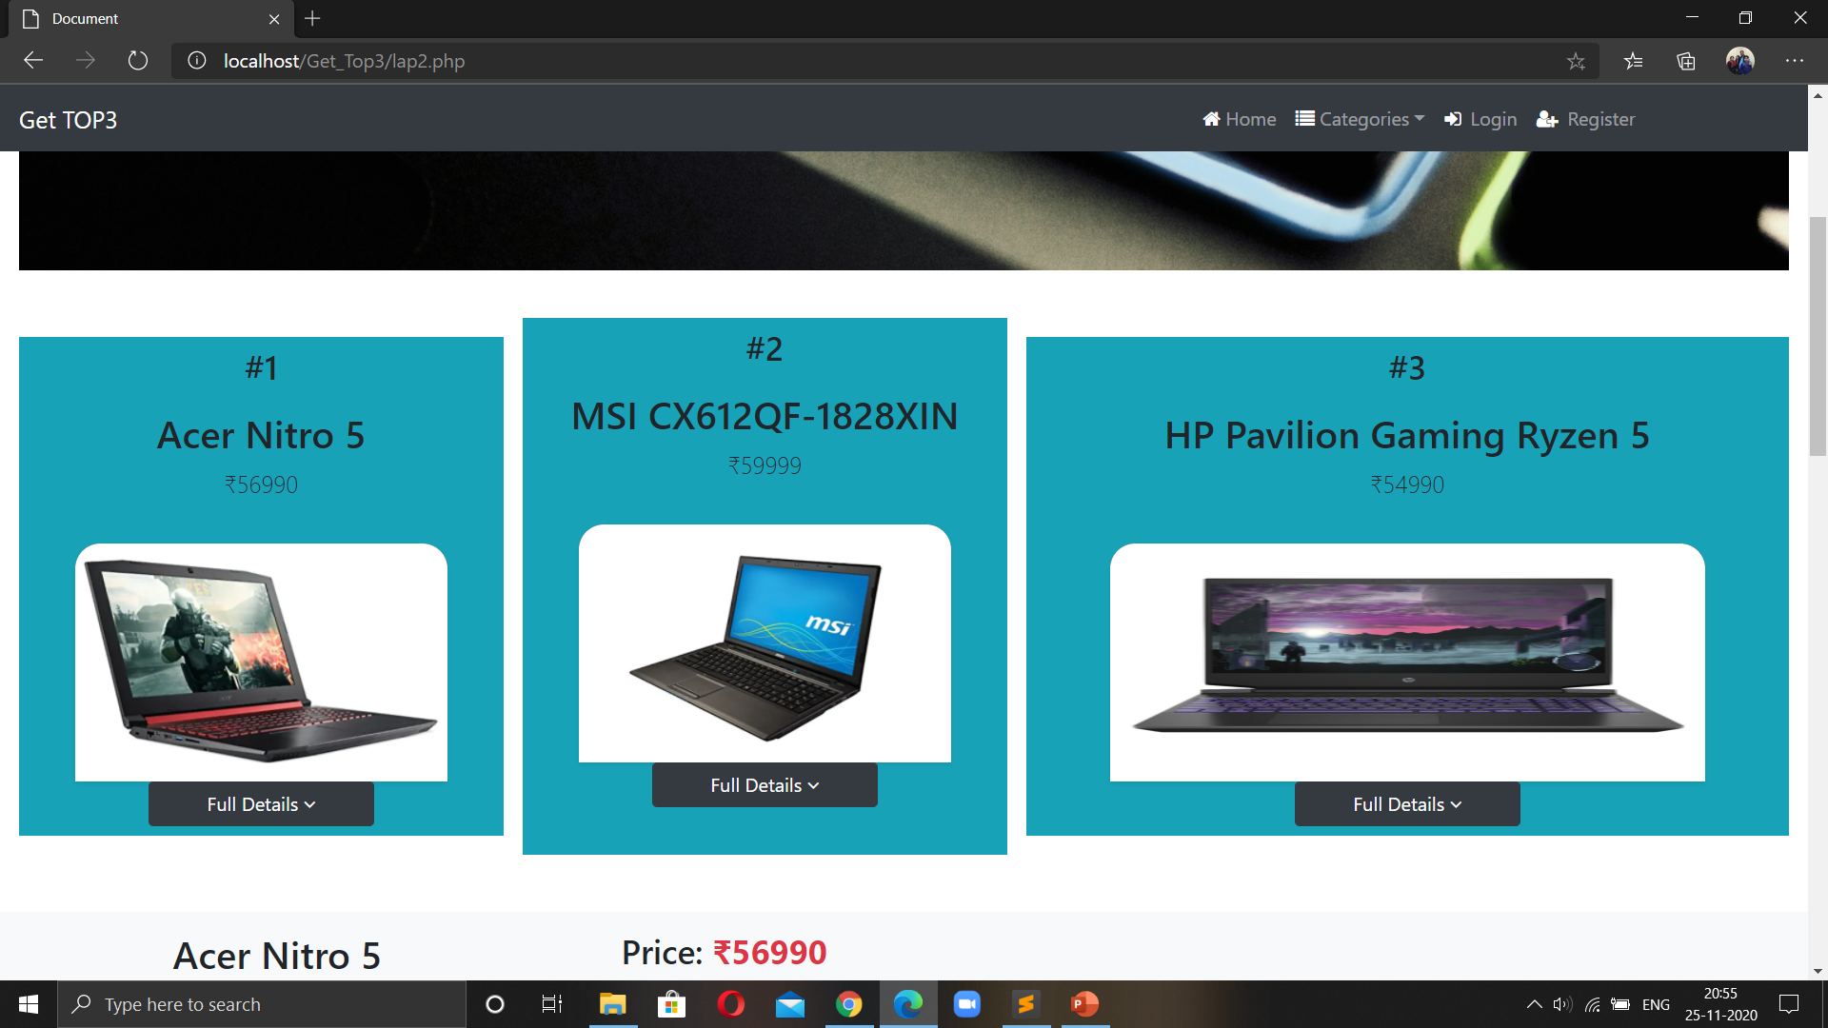

Slide 18
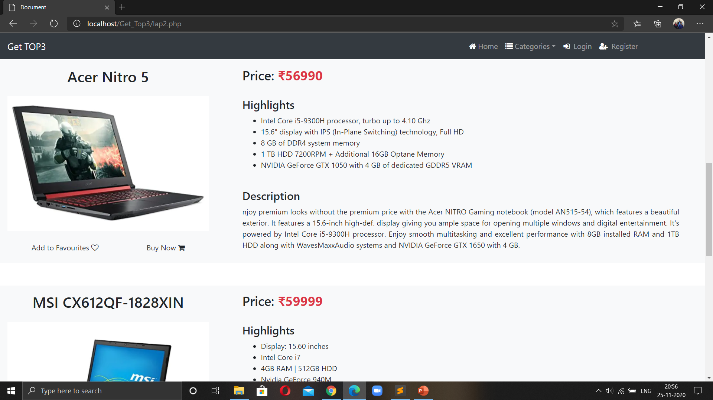

Slide 19
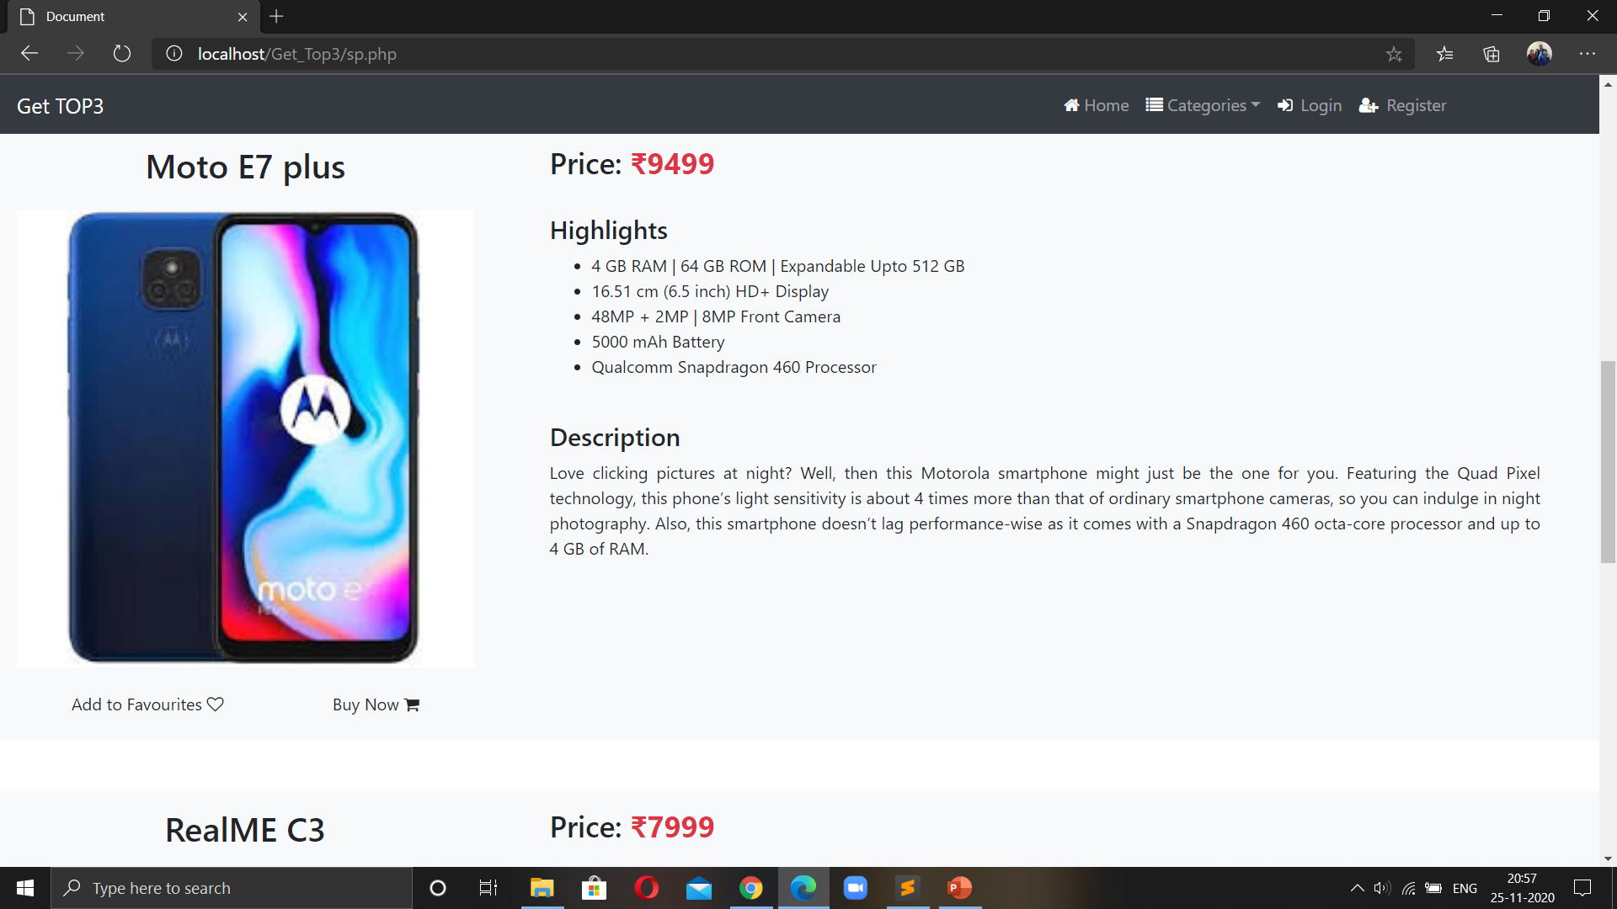

Slide 20
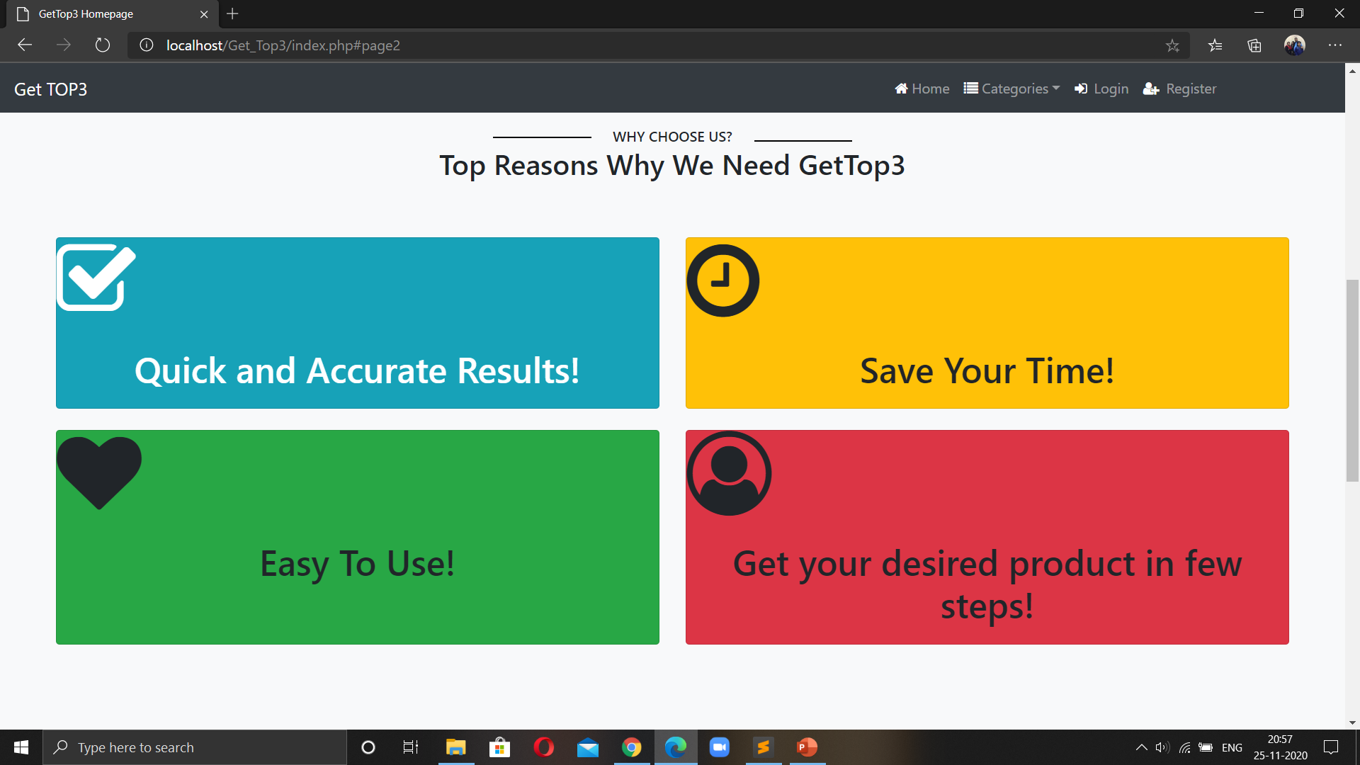

Slide 21
About the Project
This website helps the customer to find different gadgets, their features, and new updates quickly. It is designed in such a way that one can view all the updates from any place through online and can save them for later reference. It will provide a quick and easy comparison of different products for the customers.
Modules
Login: This module is for the users who already have their account.The fields in login are username and password. If the username and password are correct then it is directed to the next page.

Slide 22
New user: This module is for the users who do not have their account. Here user is allowed to create an account to login. The account creation is done by filling the registration form with user details such as name, phone, email etc.
Product: This module has information regarding the mobiles such as its name, model, color, price information, its features etc. The USER can view the Mobile, add to cart etc.

Slide 23
Applications
Some of the application of this project:
Get top3 will minimize the people’s burden as they no longer have to compare all the products on their own.
This project will be beneficial for every age group who remain confused about which products to purchase.

Slide 24
Future scope
1. This system will reduce the manual operation done by people.
2. People can directly get the specified products from the specification they submit.
3. Quick and accurate results.
4. People will be able to redirect to the link of the website where the desired product is available.

Slide 25
THANK YOU

